Slide 1



Slide 2



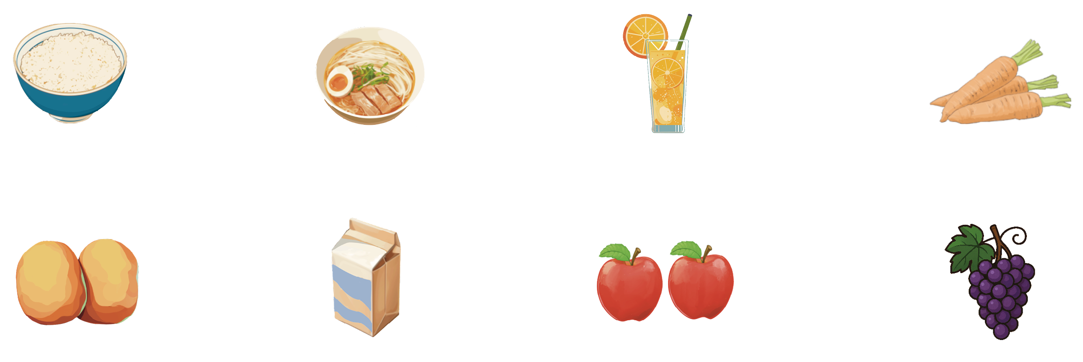
A
Look at the pictures, learn the food words and put them into the correct groups.
看图学习食物单词，然后把它们归类。
rice
noodles
juice
carrots
potatoes
milk
apples
grapes
Vegetables：______________ Fruit：____________________
Drinks：__________________ Main Food：______________
carrots, potatoes
apples, grapes
juice, milk
rice, noodles

Slide 3


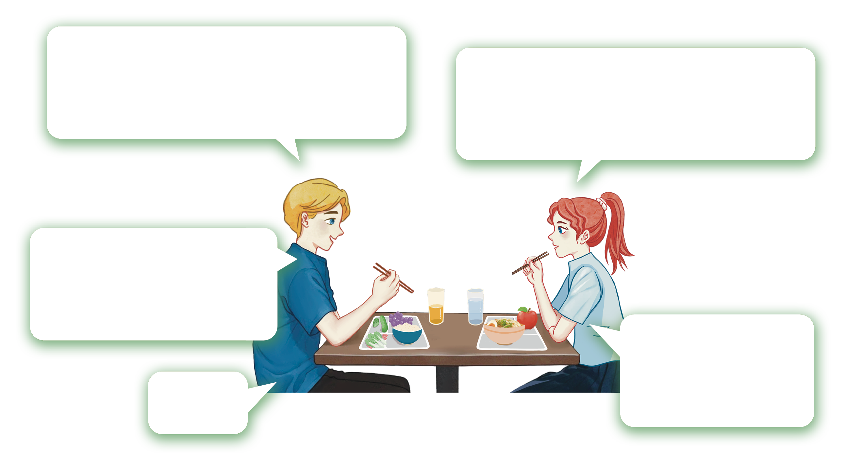
B
A
A
Listen and fill in the blanks with the words in . 听录音，用 中的单词填空。
It’s time for lunch. What do you have today?
I have_______and an ______.
What about you?
noodles
apple
I have_________,
_____and _____.
vegetables
rice
grapes
Can I try
some _______?
Sure.
grapes

Slide 4


C
Learn more words. Then ask and answer with your partner.
拓展词汇，然后和你的同伴进行问答练习。
fish
egg
meat
chicken
A: What do you usually
have for breakfast/
lunch/dinner?
B: I usually have ...
Sometimes I eat ...

Slide 5

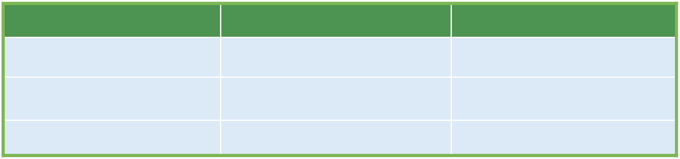
A
Discuss with your partner about the time and food you usually have for breakfast, lunch and dinner. 跟你的同伴讨论你一日三餐的时间和食物。
Meal
Time
Food
Breakfast
7:00 a.m.
bread, an egg, milk
Lunch
12:00 p.m.
...
Dinner
...
...
Example : I always have breakfast at 7:00 a.m. I usually have bread，milk and an egg.

Slide 6
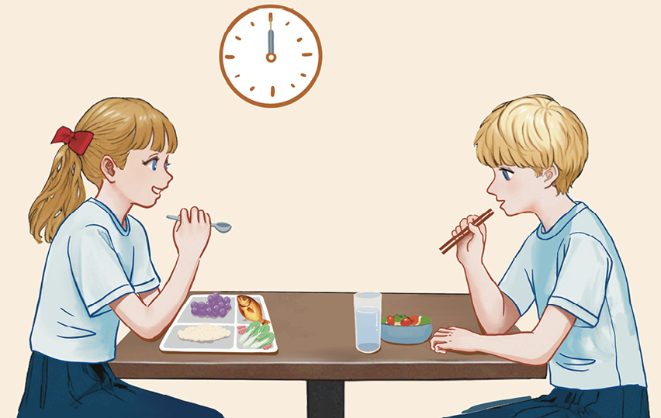

B
Listen to the conversation and complete the table . 听对话，完成表格。
Lily: Sam, why is your lunch so small?
Sam: I always eat a big breakfast and bring a small lunch.
Lily: What time do you eat breakfast?
Sam: At 7:30.
Lily: What do you usually have for breakfast?
Sam: I usually have rice, chicken, eggs and a glass of juice.
Lily: That’s a lot for breakfast!
Sam: What about you, Lily?
Lily: I usually have bread, an egg and a glass of milk at 7:00.
Sam: I don’t like milk. But I can eat rice every day. It’s my favorite!
Lily: We know, Sam! Rice for life, right?
C
Read the conversation in
and act it out with your partner.
读 中的对话，并和你的同伴表演出来。
B
Meal
Name
Time
Food
B
Breakfast
Sam
7:30
rice, chicken,
eggs, a glass of juice
Lily
7:00
bread, an egg,
a glass of milk

Slide 7

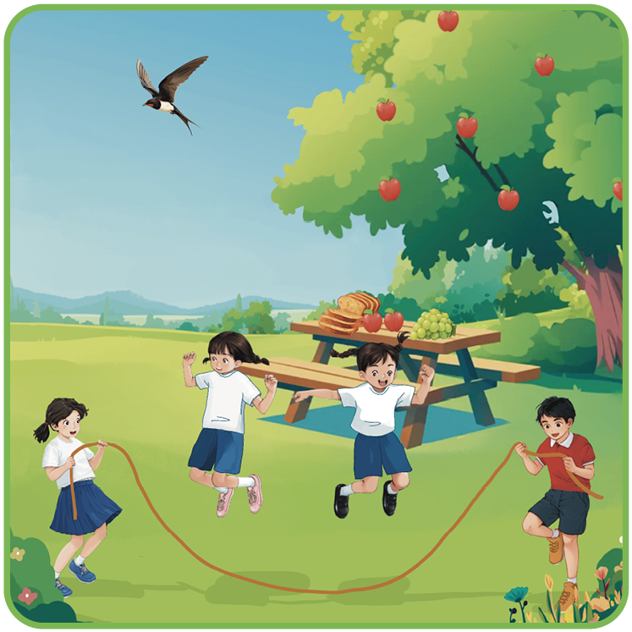
A
Listen and repeat the chant aloud. Pay attention to the pronunciation of red letters. 听录音，大声跟读韵律诗。注意红色字母的发音。
Bread is brown, and grapes are green.
Look at the fruits in the garden.
They are fresh and clean.
A black bird flies in the sky.
Flowers look bright and friends jump high.
Good food and sports bring great fun!

Slide 8

B
Listen and read the words aloud. 听录音，大声读出这些单词。
br
gr
fr
cl
pl
fl
bl
bread
grape
fruit
clean
play
fly
black
brown
green
friend
cloud
plane
flower
blue

Slide 9
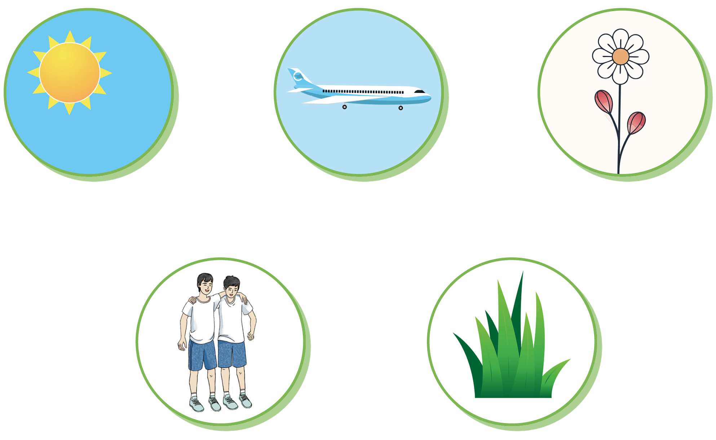

C
Complete the words based on the pictures. Then fill in the blanks with the words.
根据图片完成单词拼写，然后用这些单词完成句子。
1. My _______ and I like to play games outside.
2. The sky is _____ on sunny days.
3. The _______ is beautiful. You can’t pick it up.
4. Sheep like to eat _______ _______.
5. A _______ can fly high in the sky.
brother
__ __ ue
__ __ ane
__ __ ower
b l
p l
f l
blue
flower
green grass
plane
__ __ other
__ __ een __ __ass
b r
g r
g r

Slide 10


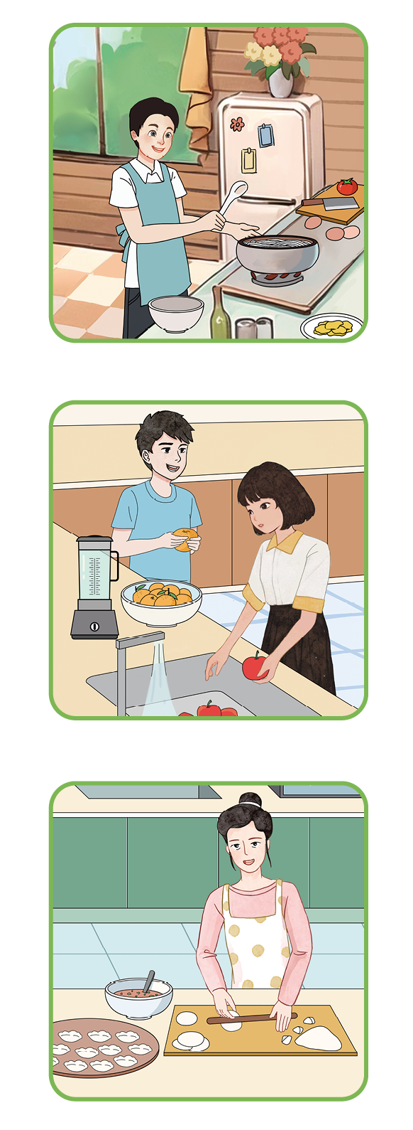
A
Read the conversations and match them with the correct pictures.
读对话，然后与正确的图片匹配。
A: Can you make noodles for lunch?
B: Yes, I can. I can make noodles with
tomatoes and eggs.
A: Can you make dumplings?
B: No, I can’t. But my mother can make
them really well.
A: What can you do for our picnic?
B: I can make apple juice. How about you?
A: I can help to wash apples.

Slide 11
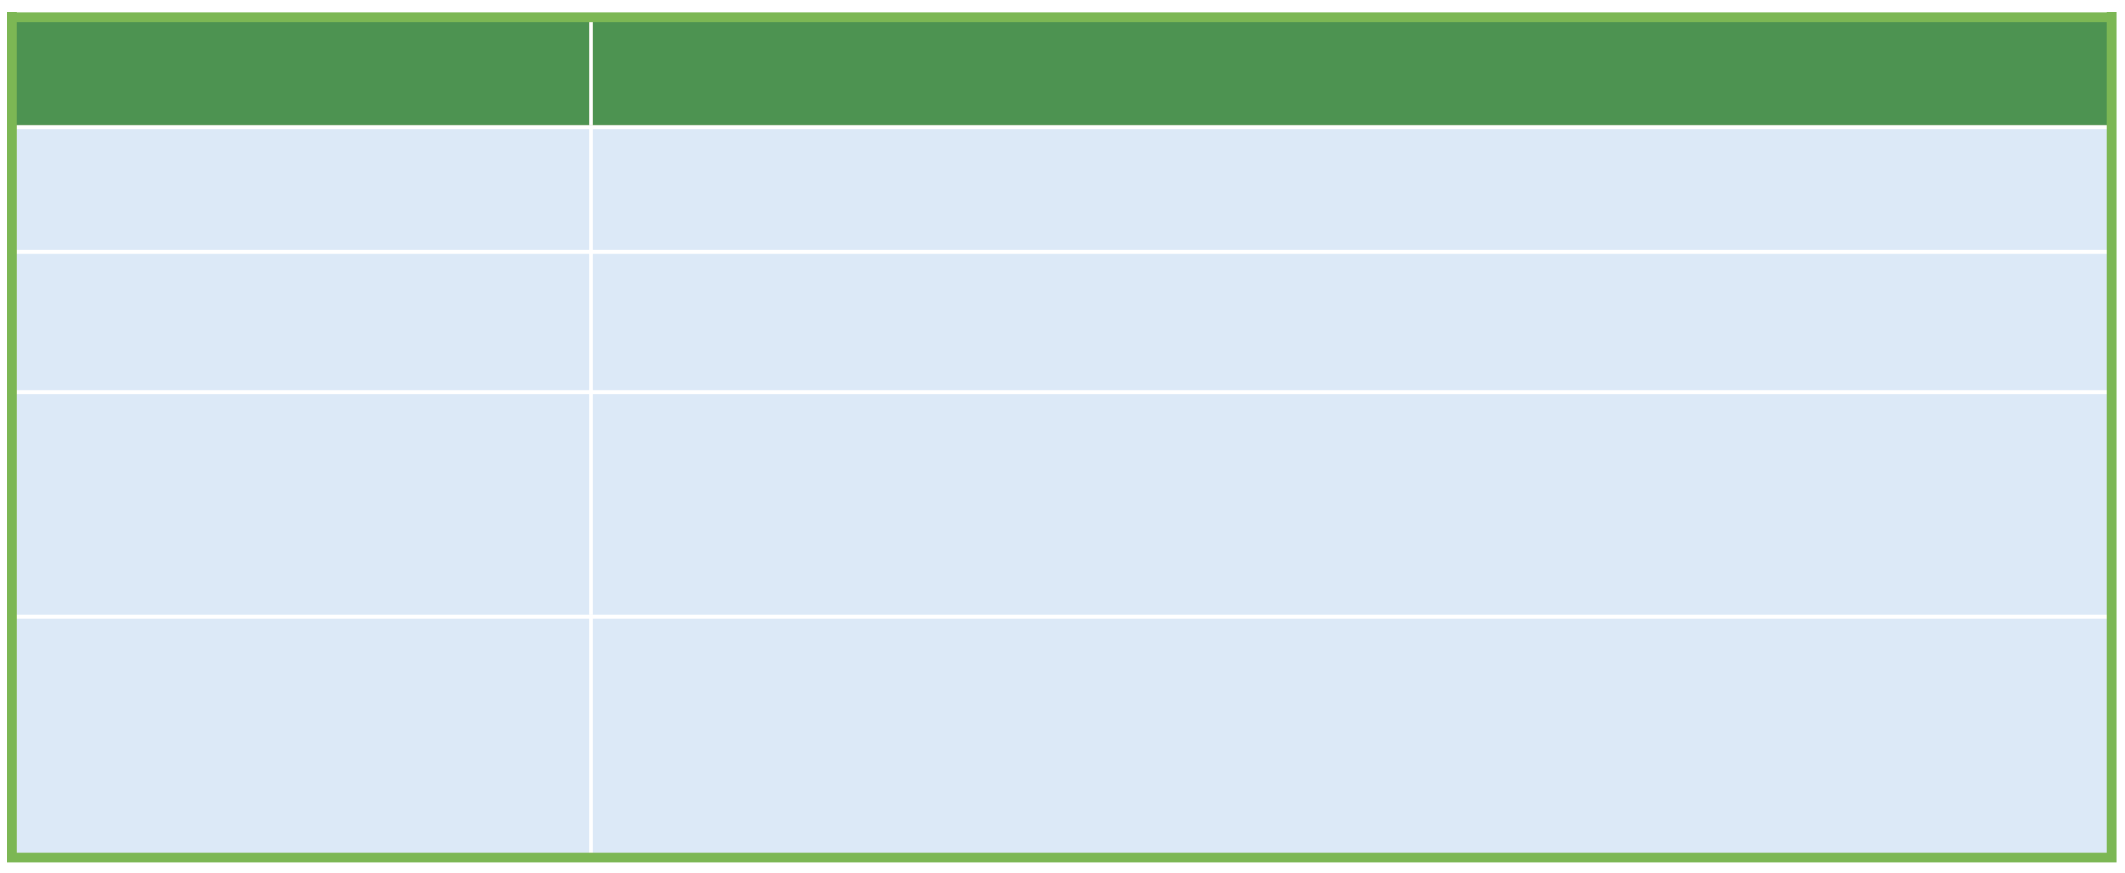
B
Lear how to use the modal verb can and fill in the blanks.
学习如何运用情态动词can并填空。
Sentence Type
Example
Positive
The boy ____ make noodles for his family.
can
Negative
We______ make dumplings.
can’t
—Can your mother make dumplings well?
—Yes, ____ ____./ No, ____ ____.
Yes/No question
she can
she can’t
—What ____ you do for our picnic?
—We ____ ______ apple juice and orange juice.
Wh-question
can
can make

Slide 12
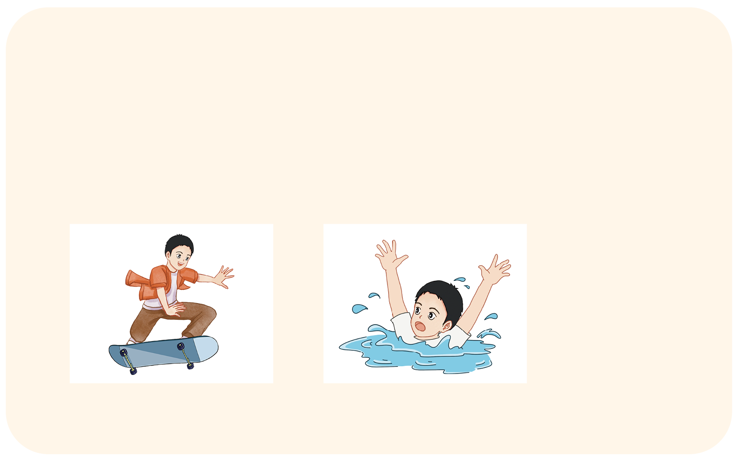
C
Talk with your partner about what you can or can’t do.
跟你的同伴讨论你能做或者不能做的事情。
1
2
Example: I can skate very well.
I can’t swim.

Slide 13

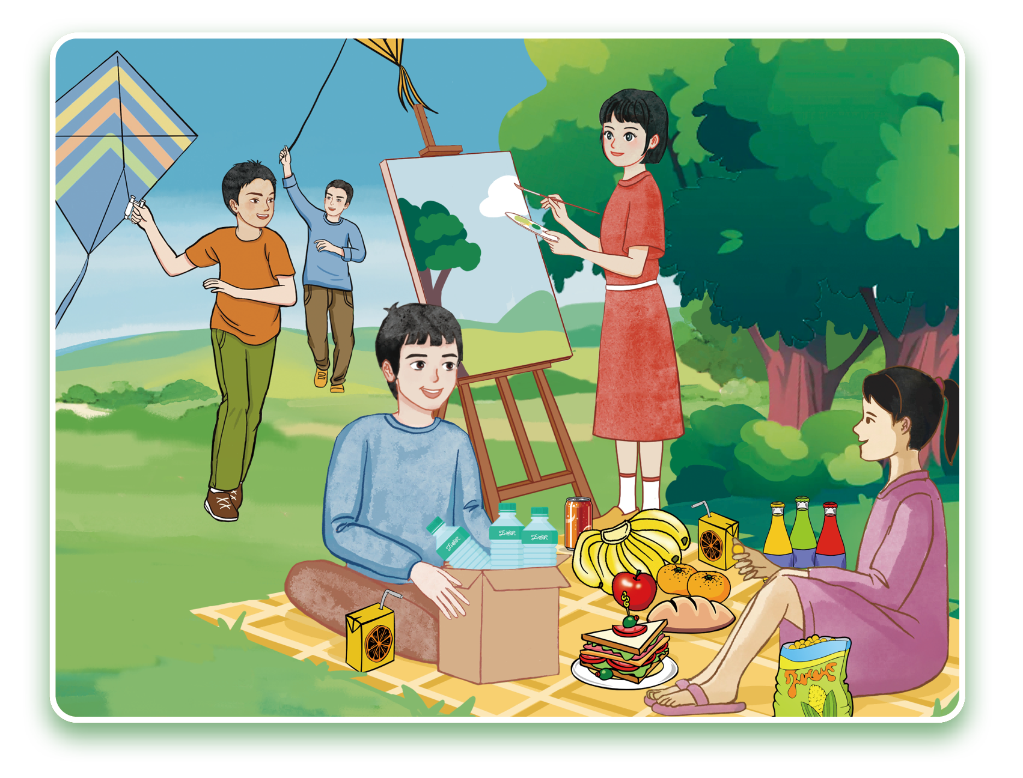
A
Look at the picture and talk about what they do and what food they have with your partner. 看图，和你的同伴讨论他们的活动以及他们的食物。

Slide 14

B
Read and circle what each child can do for the picnic.
阅读短文，圈出每个孩子能为野餐做什么。
Our Picnic Plan
Today is Saturday. The weather is sunny, and the sky is blue. We plan a picnic in the park.
We all have a job to do. I can bring some bread and cake. Kangkang can bring some juice and water. Xiao Ya can bring some fruit. Wang Junfeng can bring a kite, and we can fly a kite. Li Xiang can take photos of us.
After the picnic, we can work as a team to clean up. I can clean the ground. Kangkang can carry the bags. Li Xiang can put things in the bag.
I’m sure we can enjoy the picnic and have a lot of fun!

Slide 15
C
Read again and fill in the blanks. 再读一遍短文，填空。
1. The weather is _____ , and the sky is _____.
2. Kangkang can bring some _____ and _____.
3. ________ can bring some fruit.
4. The children can take_______during the picnic.
5. After the picnic, they work together to_____ _____.
sunny
blue
juice
water
Xiao Ya
photos
clean up

Slide 16

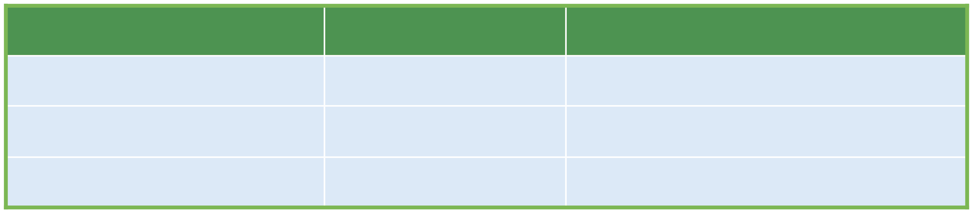
A
Suppose you are planning a picnic with your friends or family. Discuss in groups what each of you can do for the picnic.
假如你和你的朋友或家人正计划一次野餐。分组讨论你们每个人可以为野餐做些什么。
Time
People
What they can do
Before the picnic
During the picnic
After the picnic

Slide 17
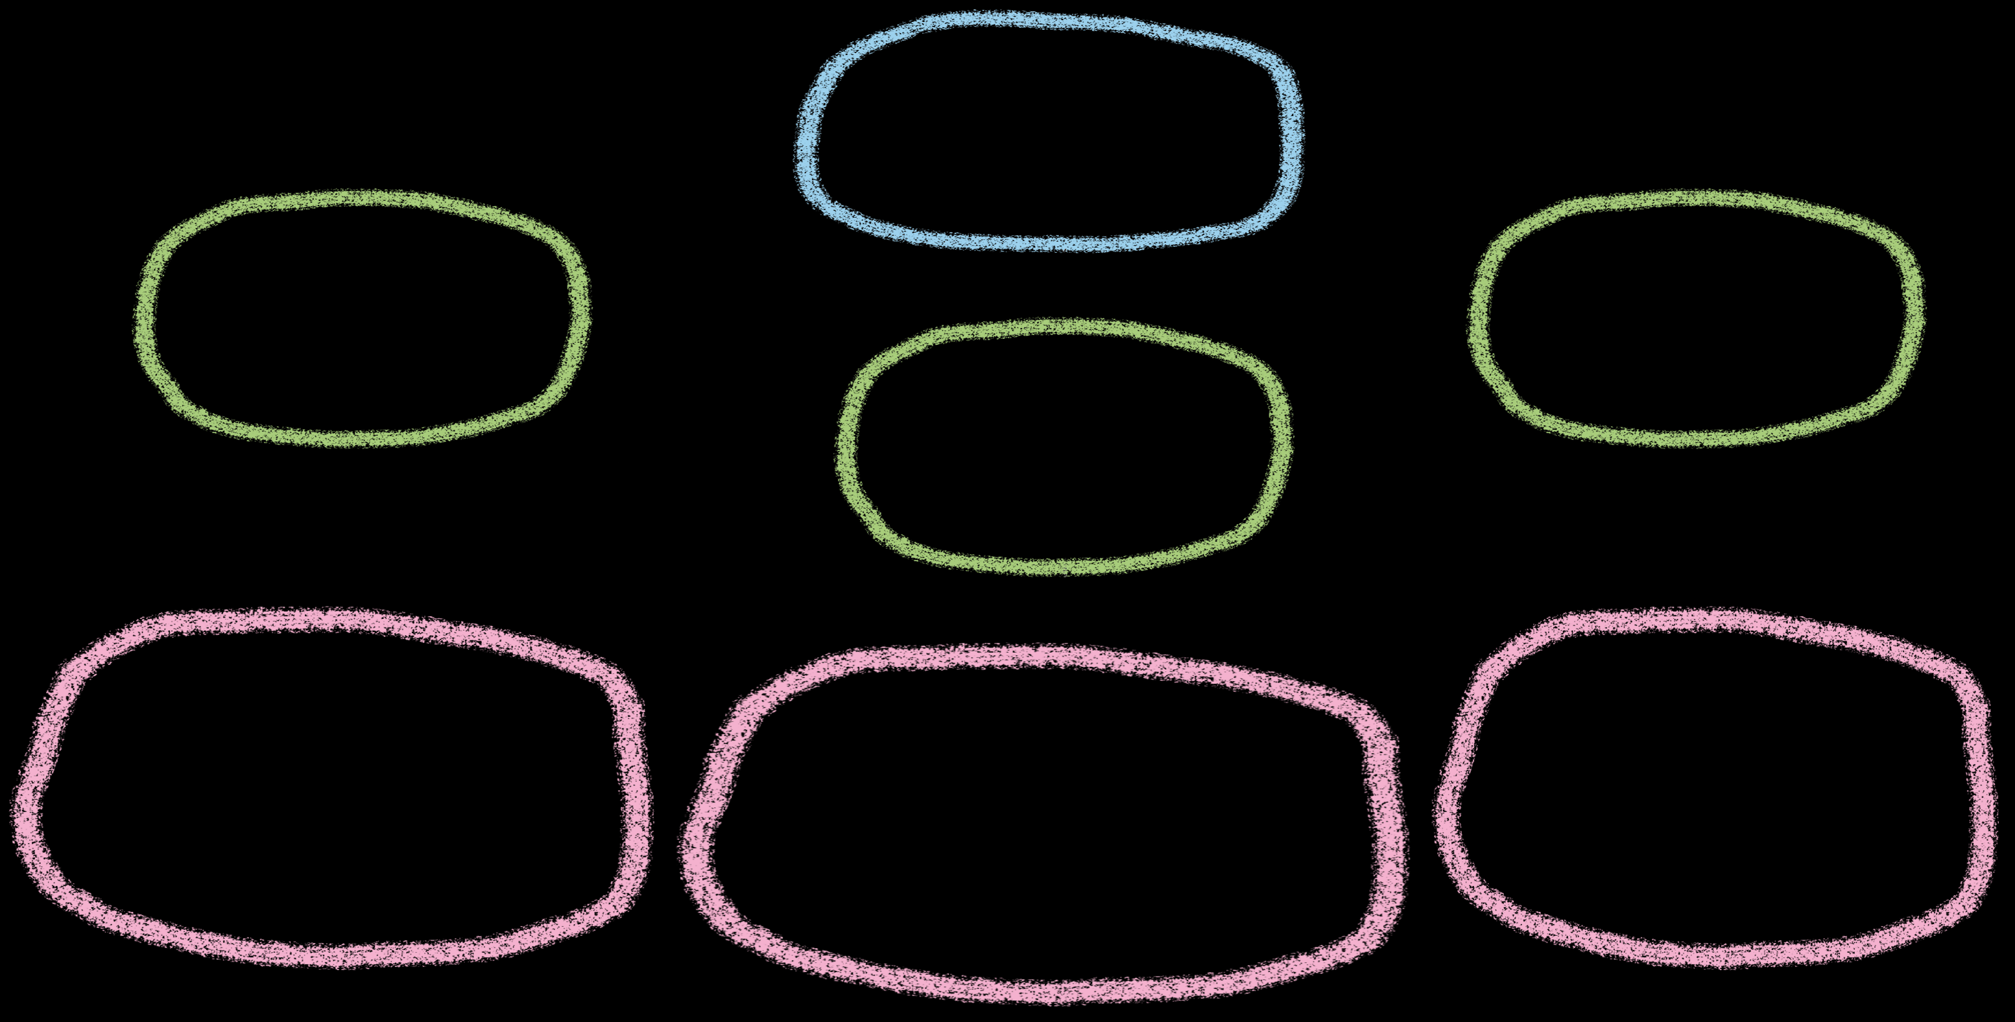
B
Use the thinking map to plan your writing. 利用思维导图构思你的作文。
My Picnic Plan
Before
After
During
1. Food: cake, ...
2. Drinks: water, ...
3. Friends/Family: ...
1. Weather: nice, good, ...
2. Activities: take photos,
play games, ...
1. Clean up
2. Share: photos, ...

Slide 18

C
Write about your picnic plan and share it in class.
写一篇有关你野餐计划的短文，并在课堂上分享。
_______________________________________________________________________
_______________________________________________________________________
_______________________________________________________________________

Slide 19


Slide 20
I.
Jack and Lily are talking about meals. Listen to the conversation and choose the correct answers. 杰克和莉莉正在谈论一日三餐。听对话，选择正确的答案。
( ) 1. What does Lily usually have for breakfast?
A. Bread and milk.
B. Bread and coffee.
C. An egg and milk.
Jack: Hi, Lily! What do you usually have
for breakfast?
Lily: I usually have bread and milk. What about you,
Jack?
A
( ) 2. What does Jack have for lunch?
A. Chicken, rice, and carrots.
B. Bread and milk.
C. Noodles and eggs.
Jack: I eat an apple and drink tea for breakfast.
Lily: That sounds nice. What do you eat for lunch?
A

Slide 21
( ) 3. What does Lily eat for dinner?
A. Potatoes and meat.
B. Meat with rice.
C. Apples.
Jack: I eat rice, chicken, and carrots.
Lily: I have potatoes, fish, and some vegetables
for lunch.
Jack: Do you eat meat for dinner?
B
( ) 4. What does Jack drink for dinner?
A. Milk.
B. Tea.
C. Water.
Lily: Yes, I eat meat with rice and drink some water.
What about your dinner?
Jack: I eat noodles, an egg and drink milk.
A

Slide 22
II.
Complete the sentences with the help of the first letters.
根据首字母提示完成句子。
1. Sam always h________breakfast at 7:00 a.m. before school.
2. Lily enjoys d________tea, but Sam likes water.
3. Every evening, my mom c________rice, vegetables and meat for my family.
4. In the morning, Lingling sometimes b________an apple to school.
5. For breakfast, I usually have a g________of milk.
as
rinking
ooks
rings
lass

Slide 23

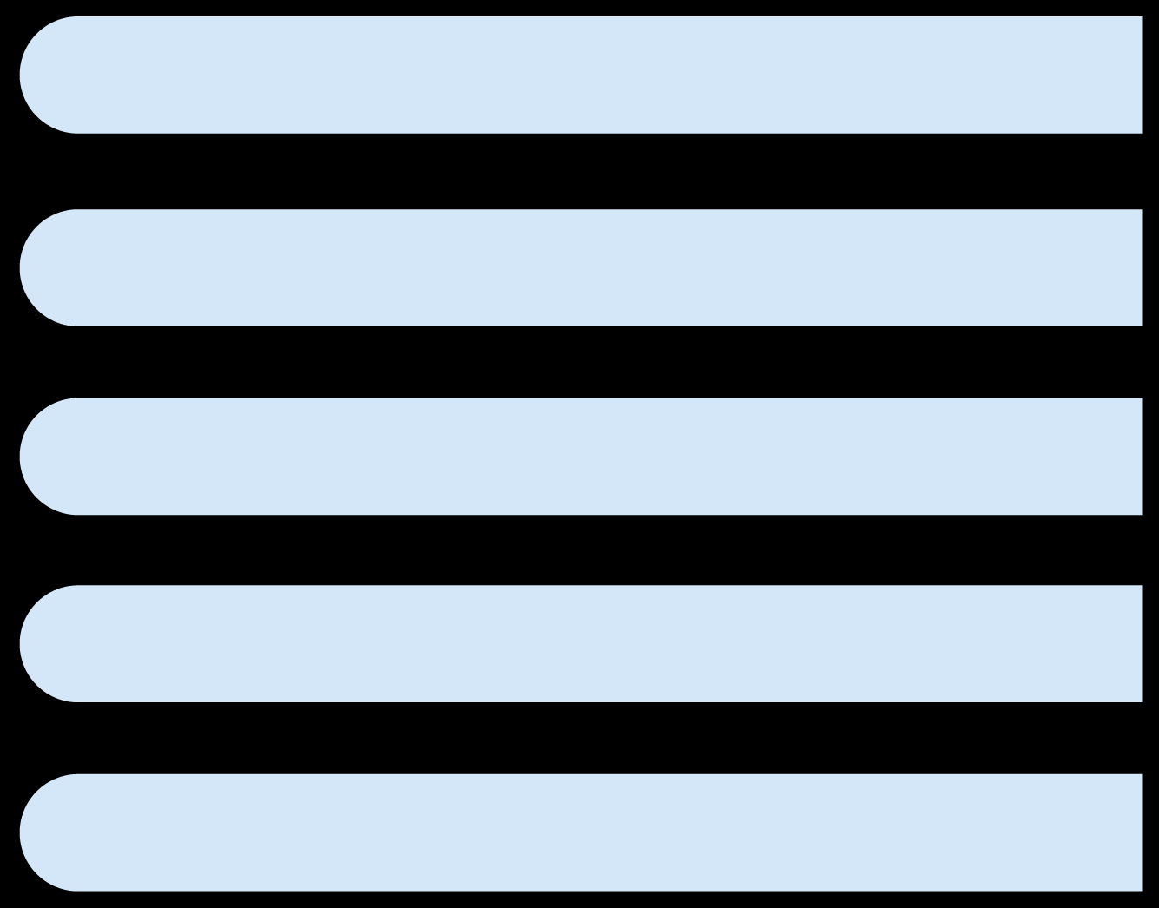
III.
Match each question with the answer. 问答匹配。
1. What do you have for breakfast?
A. I bring apples and grapes.
2. When do you usually have dinner?
B. I have bread and milk.
3. Do you like eating rice for lunch?
C. At 6:30 in the evening.
4. Why do you drink tea after meals?
D. Yes,I do. I eat it with chicken.
5. What do you bring for snacks at school?
E. Because it helps me feel relaxed.

Slide 24

IV.
The words are missing their starting sounds. Fill in the missing part with the help of the clues and read aloud the words.
这些单词缺少起始音。根据提示填写缺少的部分并大声读出单词。
__ __ ead
__ __ ape
__ __ iend
__ __ owers
__ __ y
( You eat this at a picnic. )
( A kind of fruit. )
( You play together. )
( They have different colors. )
( A bird does this in the sky. )
b r
g r
f r
f l
f l

Slide 25
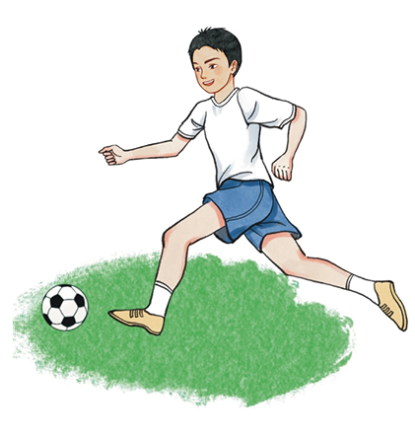
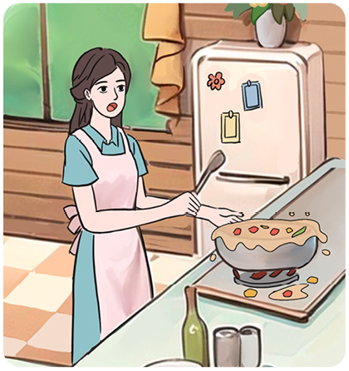
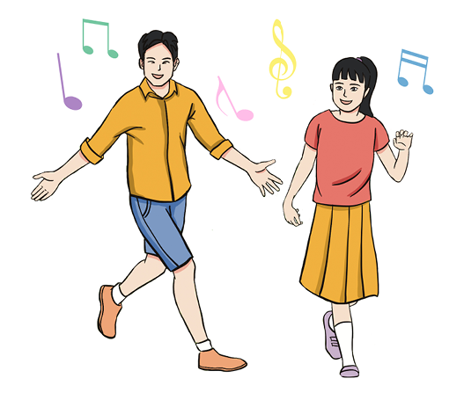
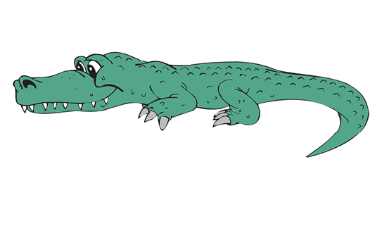
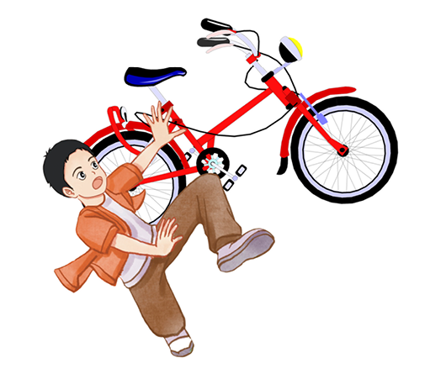
V.
Look at the pictures and answer the questions. 看图，回答问题。
1.
2.
—Can Junfeng play football?
—________, he ________.
—Can Alice cook well?
—___________________.
1
Yes
can
No, she can’t
3.
4.
—Can your friends dance?
—___________________.
Yes, they can
—Can it fly?
—___________________.
5.
No, it can’t
—Can Tom ride a bike?
—___________________.
No, he can’t

Slide 26

VI.
Make sentences using can or can’t according to the table.
根据表格信息用 can 或 can’t 造句。
Name
Cook
Make a salad(沙拉)
Bake(烤)a cake
Alice
√
×
×
Ben
×
√
×
Cindy
×
√
√
Example : Alice can cook, but she can’t make a salad or bake a cake.
_________________________________________________________
_________________________________________________________
Ben can’t cook or bake a cake, but he can make a salad.
Cindy can’t cook, but she can make a salad and bake a cake.

Slide 27
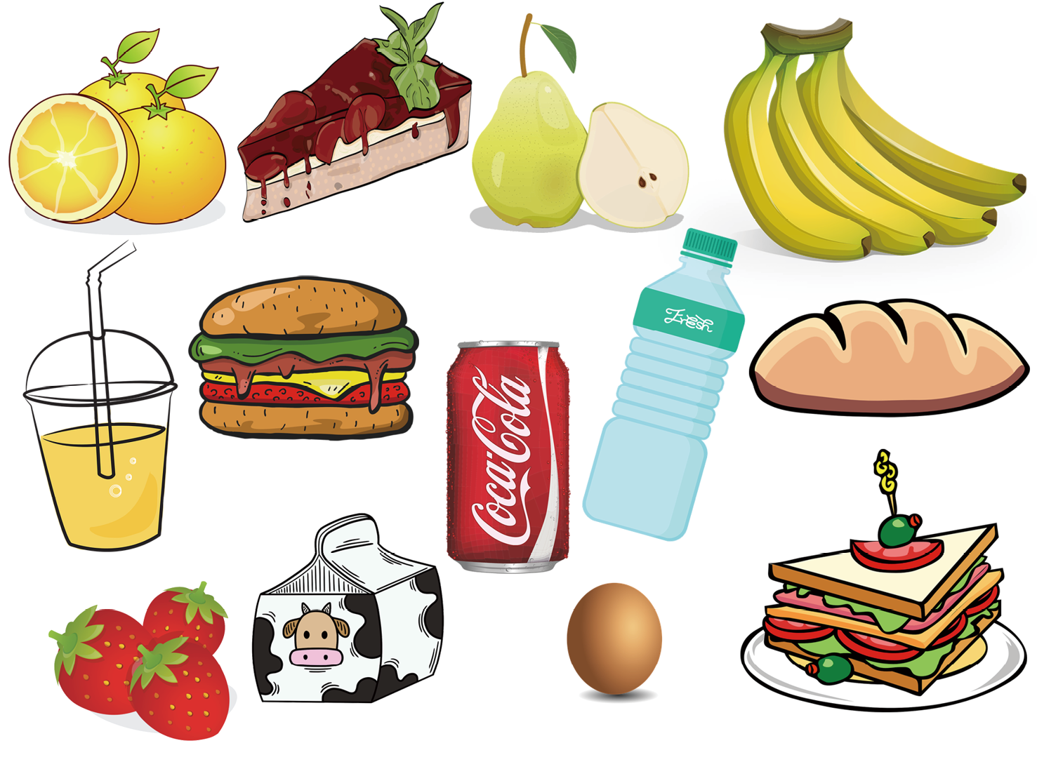

VII.
Look at the picture of picnic food. Write as many words as you can in the box.
看这张野餐食物图片。在方框中写出尽可能多的单词。
orange cake pear banana
____________________________
____________________________
____________________________
____________________________
juice hamburger coke
water bread strawberry
milk egg sandwich

Slide 28

VIII.
Read the letter from Li Hua. Choose the correct answer from A, B or C.
阅读一封来自李华的信。从A、B、C三个选项中选择正确的答案。
Dear Aunt,
How are you these days? We are getting ready for a picnic now! All of ________ have a job to do for the picnic. I make fruit juice. My mom ________ some noodles, and my dad makes a big salad. My big ________ helps carry the baskets. He is tall and strong. Grandma makes a big cake. We all work together to________!
We are so happy! I hope you ________ join us this afternoon.
Yours,
Li Hua
1
2
3
4
5
( ) 1. A. we B. us C. our
( ) 2. A. cooks B. puts C. brings
( ) 3. A. sister B. friend C. brother
( ) 4. A. make B. help C. sleep
( ) 5. A. can B. are C. do
B
A
C
B
A

Slide 29

IX.
Read the text and mark T or F. 阅读短文，判断正（T）误（F）。
Today is Sunday. The sky is very clear. Three friends have a picnic in the park. Peter makes hot dogs. Tina makes a fruit salad. Cindy helps set the table with plates and cups. They sit under a big tree. The grass is soft and green, and there are colorful flowers all around. Everyone laughs, eats, and plays games. After the picnic, they work together to clean up. Peter picks up the rubbish. Tina washes the cups, and Cindy puts the plates back in the basket. The park looks clean again. They all have a great time!
( ) 1. Peter makes hot dogs at the picnic.
( ) 2. Tina sets the table with plates and cups.
( ) 3. Cindy makes a fruit salad.
( ) 4. They sit under a big tree.
( ) 5. The park looks clean again after the picnic.
Word Bank
T
F
1. set 放；置
2. plate 盘子
3. rubbish 垃圾
F
T
T

Slide 30

X.
Imagine you are one of the children at the picnic. Write about what you can do to help and how you feel during the picnic.
想象你是野餐中的一员。写下你可以帮忙做什么以及你在野餐时的感受。
Example : I am Cindy. I can ... I feel very ... because I ... After the picnic, I help ...
I am Cindy. I can help make a fruit salad and set the table with plates and cups. I feel very happy because I enjoy playing together with my friends. After the picnic, I help pick up the rubbish. We all have a fun time!
_________________________________________________
_________________________________________________
_________________________________________________
_________________________________________________
_________________________________________________
_________________________________________________
_________________________________________________

